Slide 1
ALASS Infotech Solution
Placement Consultancy , Data Processing
Marketing and Tuition
Nothing Is Impossible

Slide 2
Profile
1 .Placement Consultancy
2 .Data Processing
3 .Marketing
4 .Tuition

Slide 3
ALASS Infotech Solution
Placement Consultancy

Slide 4
Placement Consultancy
Engineering & Manufacturing
Service Enginer
Telecaller
Automotive
IT & ITES
Media & Entertainment
Retail
Insurance
Hotel,Hospital
Education
Real Estate, Infrastructure, Construction
ALASS provides services in following Industry sectors

Slide 5
Register/ Search Candidate
Training
1
4
Training Centre can register new candidates and search already registered or enrolled candidates
During training period, Training Centre can update candidate dropout/ update attendance/ etc.
Create Batch
Campus Placement
2
Training Centre can create batches against the Job Roles he is empanelled for, only if target is allocated
5
Campus placement, also known as campus recruitment, is when companies come to your colleges campus, conduct interviews, and hire candidates to work in their company
Enrol/ Reject Candidate
3
Training Centre can view candidate application and enrol/ reject the candidate.

Slide 6
Placement Training
Know Yourself
Creative Thinking
- Psychometric Analysis
- SWOT Analysis
Understand Your Personality
- Mind Mapping
- Rebus Puzzles / Problem Solving
- Structured and Unstructured Ideas
- Analytic and Research Skills
Analytical and Descriptive Writing
1
3
Building Blocks
Positive Psychology
2
- Motivation and Confidence Building
- Time Management
- Goal Setting
- Ethics and Integrity
- Stress Management
- Basic Presentation Skills
- Adaptability
- Team Work and Interpersonal Skills
- Leadership Skills
4
- Introduction
- Positive Emotions, Habits, Changes
- Living a Good Life
- Fulfilling Relationship
Overcoming Tough Times
6

Slide 7
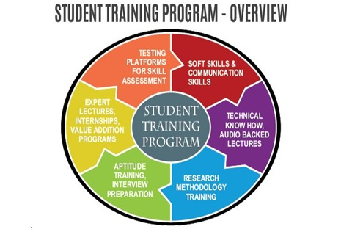

Slide 8
How to Prepare For College Placement
Check your aptitude
There are different kinds of aptitude tests. They can be to test your:
Communication
Logical reasoning
Domain knowledge
Quantitative ability
Group Discussions
Group discussions are generally said to revolve around current topics. Here are some simple tips to prep yourself for it:
Learn to speak up when you have a point
Be polite and welcoming of others’ opinions
Keep your language extremely professional
Understand the intentions right before you proceed to oppose someone point
Always make sure to keep the discussion a group discussion and not turn it to a debate
Have good clarity of voice and a proper tone
Gather your friends and do mock discussions to help you prepare well. The main intention of a GD is to discuss Group discussions as an excellent opportunity to showcase the best of your abilities. This is where you can create an impression on your speaking abilities.

Slide 9
How to Prepare For College Placement
Panel Interview
A panel interview is where a group of people interviewing you to understand your capabilities. It generally consists of a group of three to four or five people who will evaluate your skills. People often get intimidated at this round mostly by seeing more than one person on the panel. Speak with clear thoughts and never give room to any ambiguity.
HR Interview
Research well
Body Language
Fillers
Common interview questions

Slide 10
ALASS Infotech Solution
Data Processing

Slide 11
Add your title
Search engine optimization
Search engine optimization (SEO) is the process of improving the quality and quantity of website traffic to a website or a web page from search engines As an Internet marketing strategy, SEO considers how search engines work, the computer-programmed algorithms that dictate search engine behavior, what people search for, the actual search terms or keywords typed into search engines, and which search engines are preferred by their targeted audience. SEO is performed because a website will receive more visitors from a search engine when websites rank higher on the search engine results page (SERP)..
Project
Judges/workers can work from home and get paid for doing simple tasks such as text annotation, image annotation, data collection, search relevance tasks and much more. Basically UHRS provides human intelligence to train AI applications/tools, products and machine learning models.

Slide 13
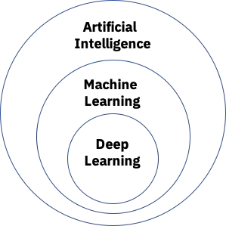
Artificial intelligence
Artificial intelligence leverages computers and machines to mimic the problem-solving and decision-making capabilities of the human mind.
Human approach:
Systems that think like humans
Systems that act like humans
Ideal approach:
Systems that think rationally
Systems that act rationally
Customer service: Online virtual agents are replacing human agents along the customer journey. They answer frequently asked questions (FAQs) around topics, like shipping, or provide personalized advice, cross-selling products or suggesting sizes for users, changing the way we think about customer engagement across websites and social media platforms

Slide 14
..
ALASS Infotech Solution
.
Marketing

Slide 15
Marketing
Digital Marketing
Digital marketing is the component of marketing that uses internet and online based digital technologies such as desktop computers, mobile phones and other digital media and platforms to promote products and services .
Offline Marketing
Offline marketing refers to any advertising that is carried out using traditional offline media, such as television, billboard ads, and radio. ... Even though many advertisers are focusing on digital marketing and advertising, traditional offline media channels are still important.

Slide 17
ALASS Infotech Solution
Tuition

Slide 18
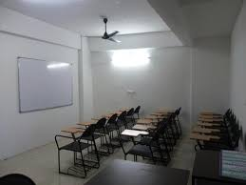
If you are looking for ALASS Tuition then we have come up with great ideas and you need to explore them. Whether you are proving home tuition or opening a center, you need to name it with something good and catchy.
In our ALASS Tuition, Teaching staff include professional personnel directly involved in teaching students, including classroom teachers, special education teachers and other teachers who work with students as a whole class, in small groups, or in one-to-one teaching.
Learn now, be successful tomorrow
Tutoring to success
Making every student competitive
Tutoring students thrive for success
Helping students to succeed
Gaining knowledge, achieve more
We are glad to help you learn
A successful career starts here
Training students to be a better person
Tutors with passion, successful students
Taking learning to the next level
Learn now, live the rest of your life comfortably
The best tutors in one place

Slide 20
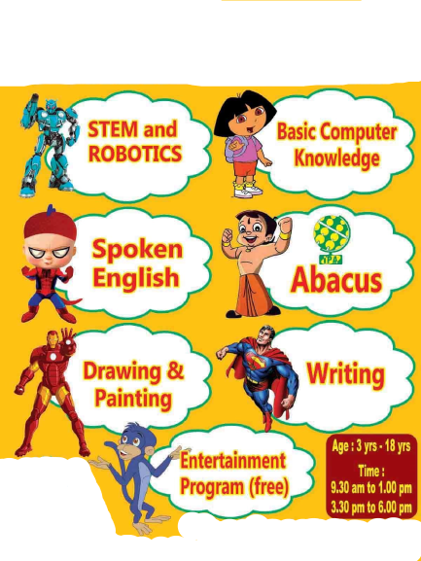

Slide 21
Sivaselvavinayagam V
Managing Director
ALASS Infotech Solution
No.2202 Ground Floor,
Om Sakthi Nagar,
Thiruvalluvar Avenue,
No.1 Tollgate,
Trichy
Pin Code:621216
0431-4340681
0431-2900681
+91-9003930681
info@alassinfotechsolution.com
alassinfotechsolution@gmail.com

Slide 22
Thank you
Elavarasi T
Manager
+91-8220548343
+91-8610089475

